Slide 1

PLMs Meet KGs
何羽鑫
8/4/2023
Ref: Unifying Large Language Models and Knowledge Graphs: A Roadmap

Slide 2
PLMs: Pretrained Language Models
LLMs: Large Language Models
(#Parameters > 1B,
Usually Generative)

Slide 3
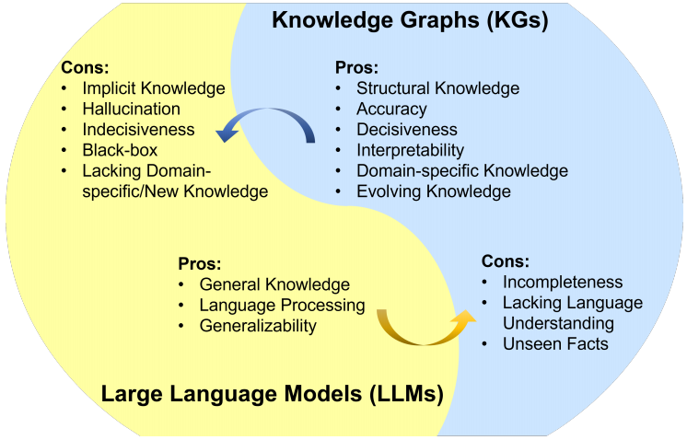
Unifying Large Language Models and Knowledge Graphs: A Roadmap

Slide 4
主要内容
1.
KG-enhanced PLMs
2.
PLM-augmented KGs
3.
Future Directions

Slide 5
KG-enhanced PLMs
预训练
微调
推理
可解释性

Slide 6
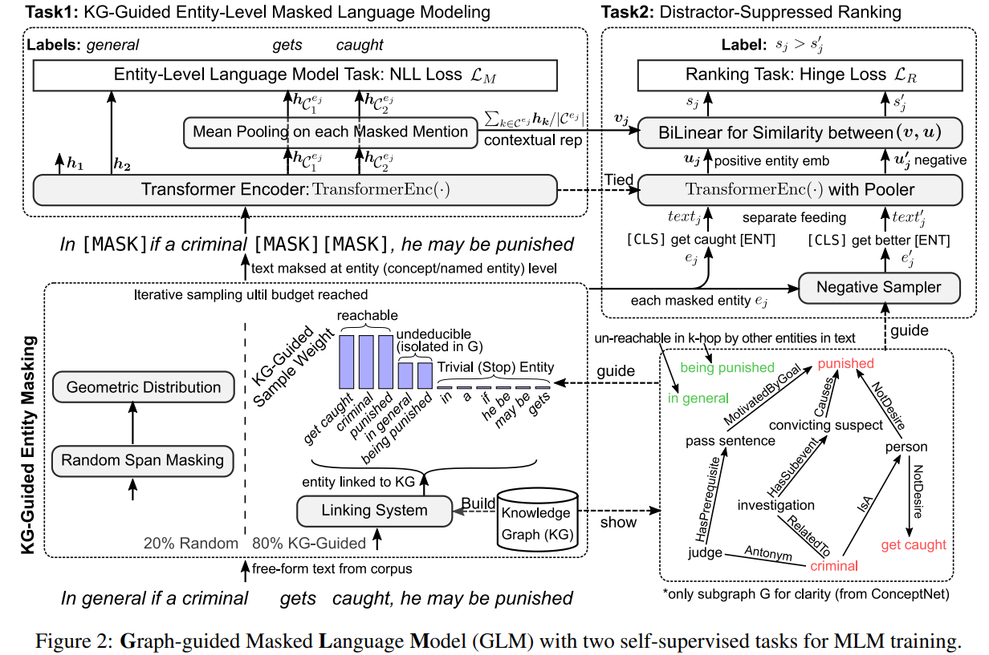
KG-enhanced PLMs: 预训练
知识图谱融入预训练目标 —— 实体级掩码
Exploiting structured knowledge in text via graph-guided representation learning

Slide 7
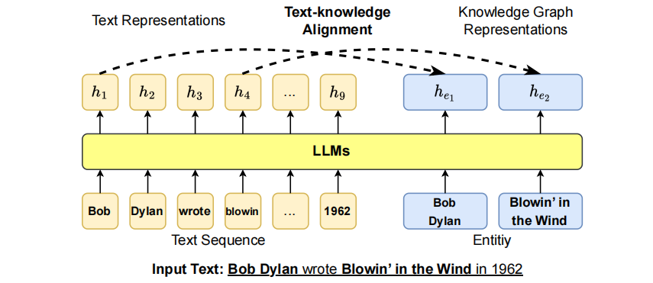
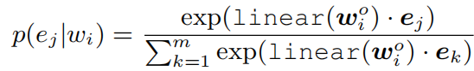
KG-enhanced PLMs: 预训练
知识图谱融入预训练目标 —— 文本-知识对齐
ERNIE: Enhanced language representation with informative entities

Slide 8
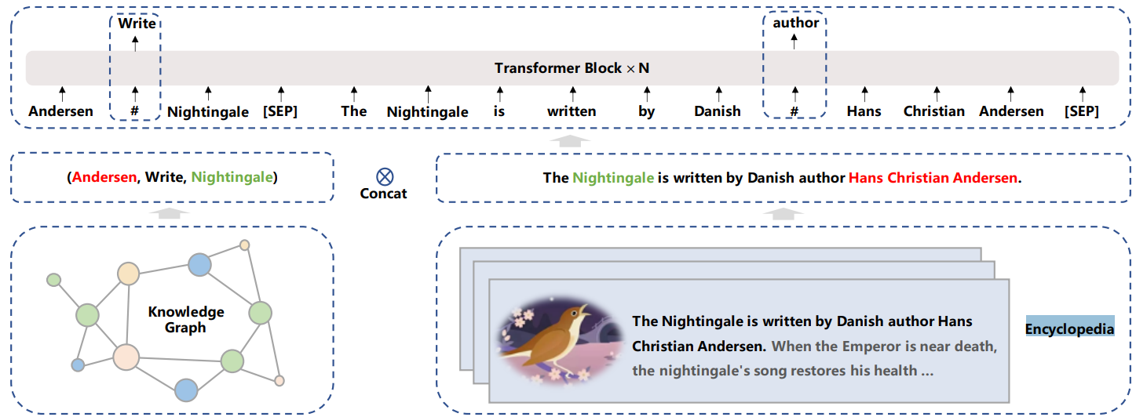
KG-enhanced PLMs: 预训练
知识图谱作为额外语境 —— 直接拼接
Ernie 3.0: Large-scale knowledge enhanced pre-training for
language understanding and generation

Slide 9
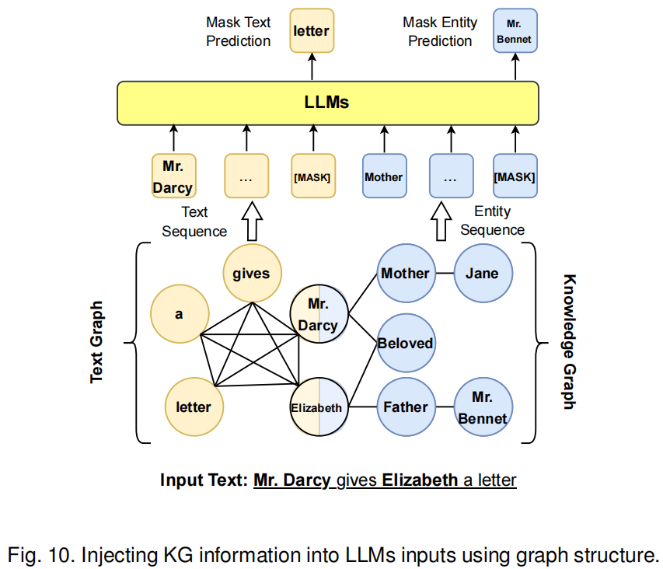
KG-enhanced PLMs: 预训练
知识图谱作为额外语境 —— 文本-知识异构图
CoLAKE: Contextualized language and knowledge embedding

Slide 10
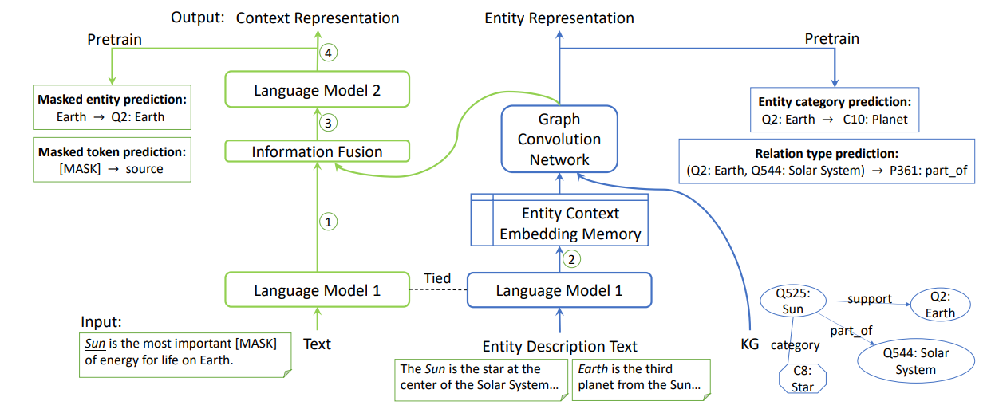
KG-enhanced PLMs: 预训练
知识图谱作为额外语境 —— 内部融合模块
JAKET: joint pre-training of knowledge graph and language understanding

Slide 11
KG-enhanced PLMs: 微调
预训练和微调的主要区别：
预训练：
无标注（自监督）
可扩展性（高效）
通用泛化能力
微调：
下游任务驱动（ Ad hoc ）
更复杂的设计（以训练效率为代价）

Slide 12
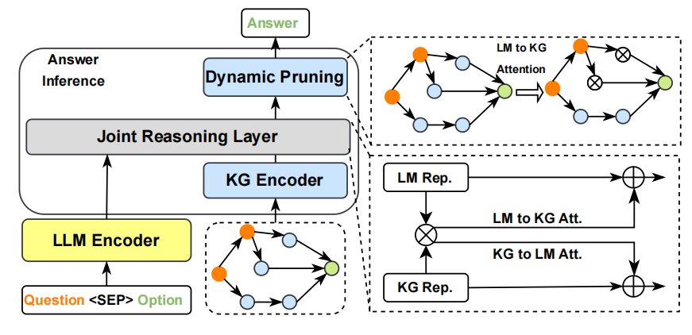
KG-enhanced PLMs: 微调
动态知识融合
JointLK: Joint reasoning with language models and knowledge graphs for commonsense question answering

Slide 13
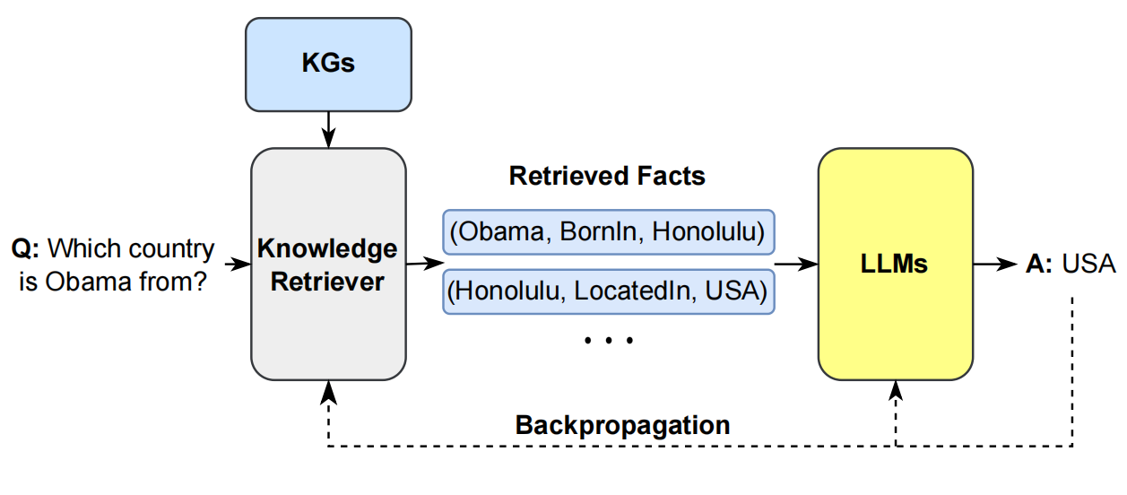
KG-enhanced PLMs: 微调
检索增强的知识融合
Retrieval-augmented generation for knowledge-intensive nlp tasks

Slide 14
KG-enhanced PLMs: 推理
In-Context-Learning
Retrieval-augmented generation for knowledge-intensive nlp tasks

Slide 15
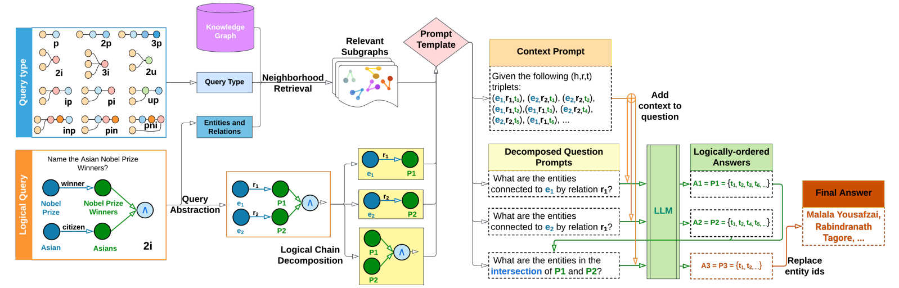
KG-enhanced PLMs: 推理
Reasoning over KGs
Complex logical reasoning over knowledge graphs using large language models

Slide 16
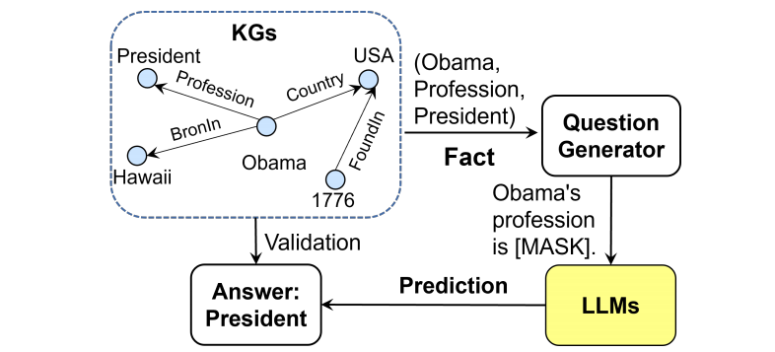
KG-enhanced PLMs: 可解释性
探测PLM隐含的知识
Language models as knowledge bases?

Slide 17
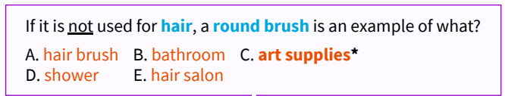
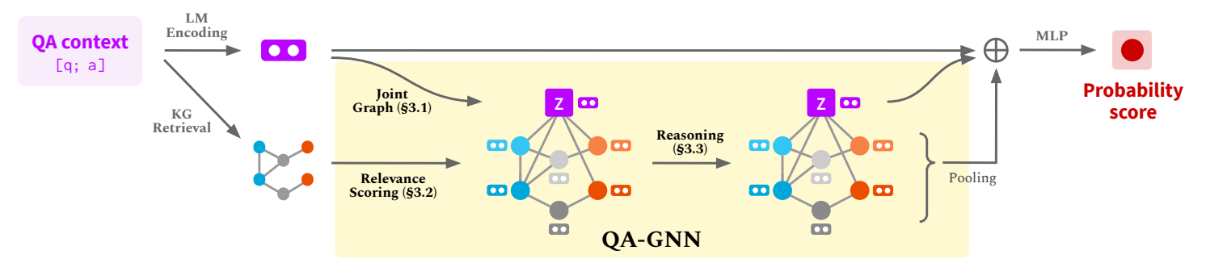
KG-enhanced PLMs: 可解释性
推理路径
QA-GNN: Reasoning with Language Models and Knowledge Graphs for Question Answering

Slide 18
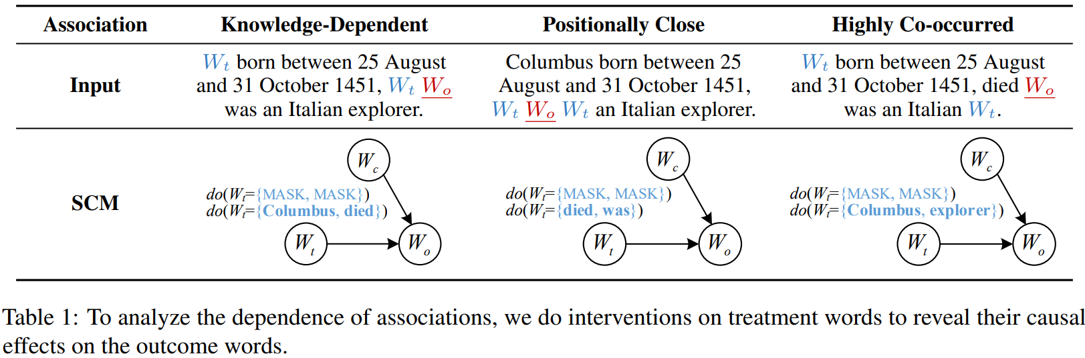
KG-enhanced PLMs: 可解释性
PLM是如何预测出被遮蔽实体的？知识性/位置性/共现性相关
20 May 1506
20 May 1506
20 May 1506
How Pre-trained Language Models Capture Factual Knowledge? A Causal-Inspired Analysis

Slide 19
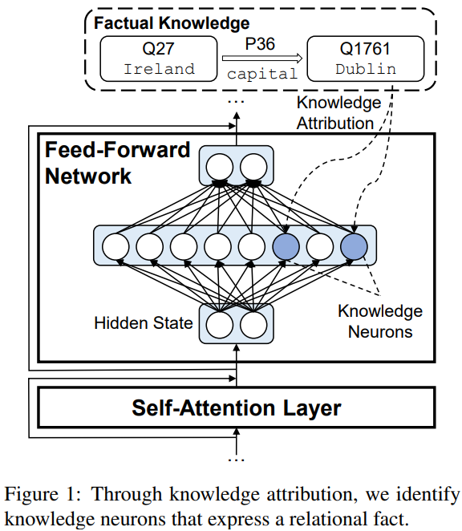
KG-enhanced PLMs: 可解释性
知识神经元
Knowledge Neurons in Pretrained Transformers

Slide 20
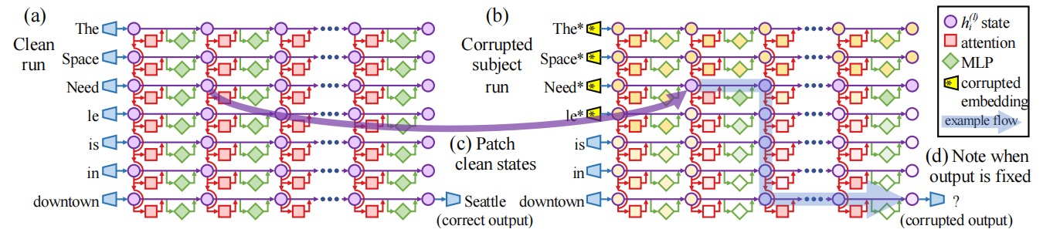
KG-enhanced PLMs: 可解释性
知识通路
Locating and Editing Factual Associations in GPT

Slide 21
主要内容
1.
KG-enhanced PLMs
2.
PLM-augmented KGs
3.
Future Directions

Slide 22
PLM-augmented KGs
图谱嵌入表示
图谱补全
图谱构建
Graph-to-Text
图谱问答

Slide 23
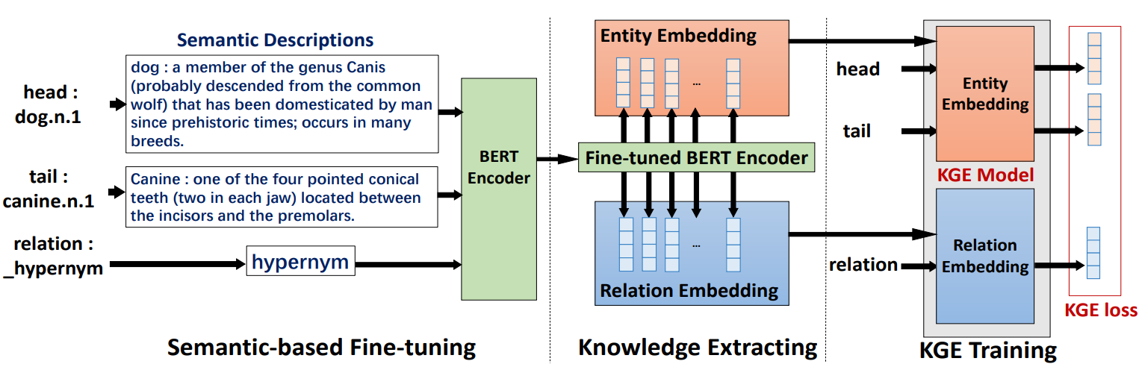
PLM-augmented KGs: 图谱嵌入表示
PLM作为文本编码器
Pretrainkge: learning knowledge representation from pretrained language models

Slide 24
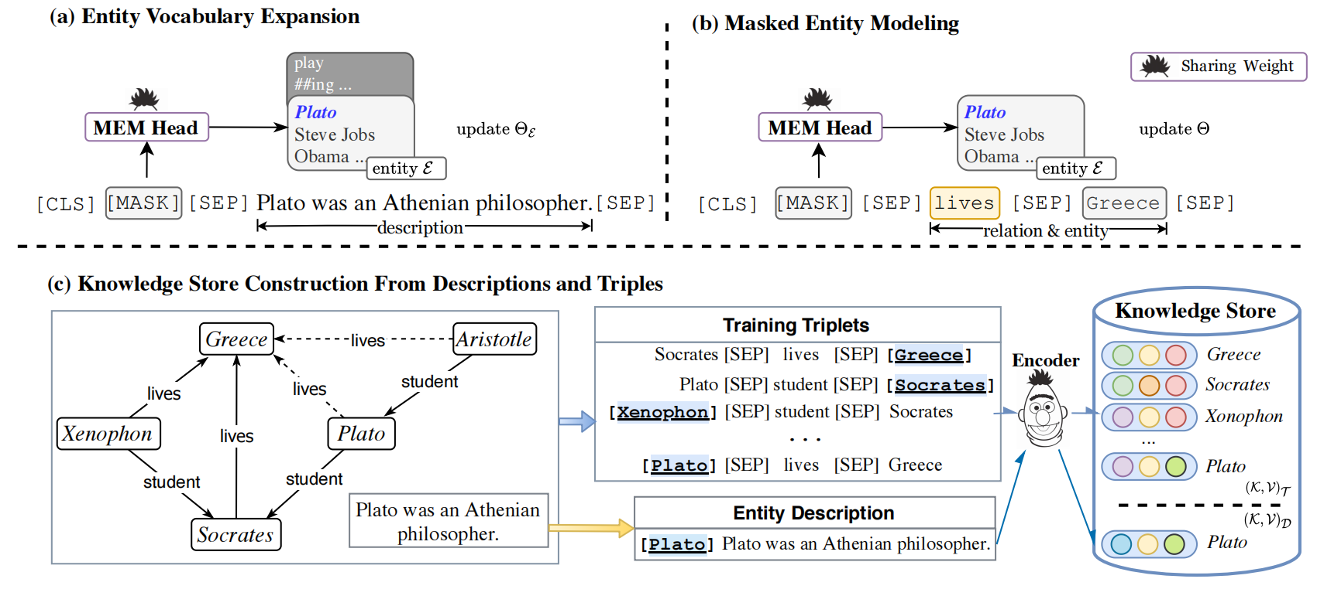
PLM-augmented KGs: 图谱嵌入表示
PLM用于文本-图谱联合编码
Reasoning Through Memorization: Nearest Neighbor Knowledge Graph Embeddings with Language Models

Slide 25
PLM-augmented KGs: 图谱嵌入表示
PLM用于文本-图谱联合编码
Reasoning Through Memorization: Nearest Neighbor Knowledge Graph Embeddings with Language Models

Slide 26
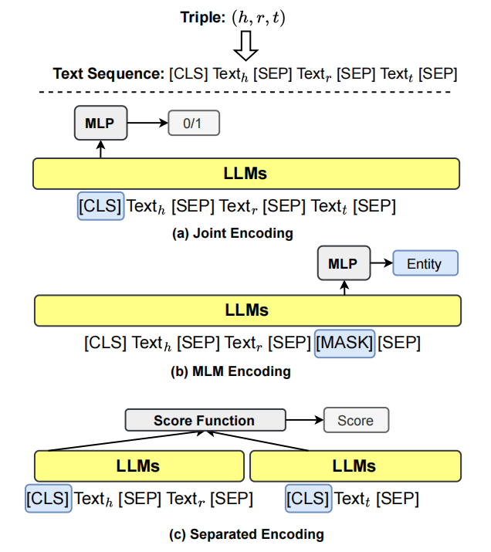
PLM-augmented KGs: 图谱补全
判别式

Slide 27
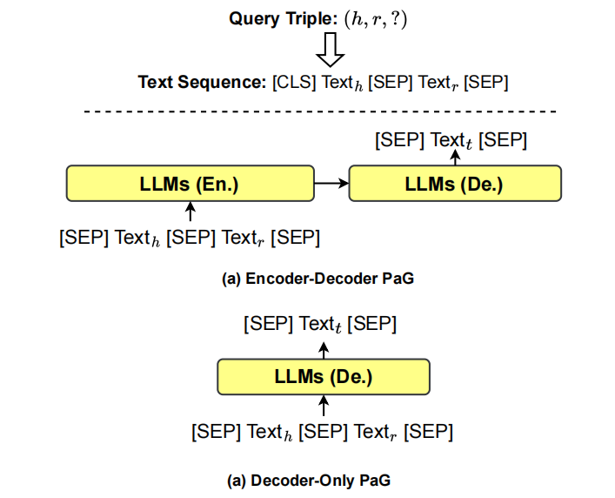
PLM-augmented KGs: 图谱补全
生成式

Slide 28
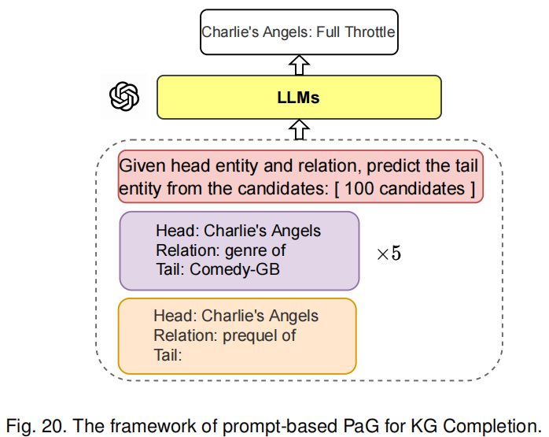
PLM-augmented KGs: 图谱补全
生成式

Slide 29
PLM-augmented KGs: 图谱构建
实体发现
实体识别
实体分类 (Optional)
实体标准化
指代消解 (Optional)
关系分类

Slide 30
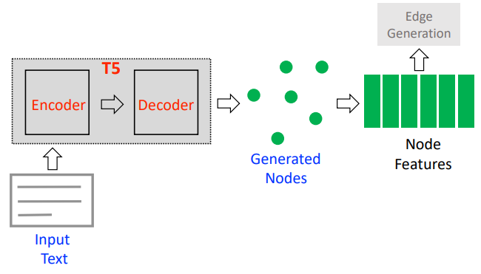
PLM-augmented KGs: 图谱构建
实体识别
<PAD> Ent₁ <NODE-SEP> Ent₂ <NODE_SEP> Ent₃ </S>
Grapher: Multi-Stage Knowledge Graph Construction using Pretrained Language Models

Slide 31
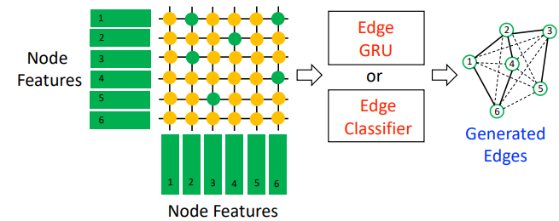
PLM-augmented KGs: 图谱构建
关系分类
Grapher: Multi-Stage Knowledge Graph Construction using Pretrained Language Models

Slide 32
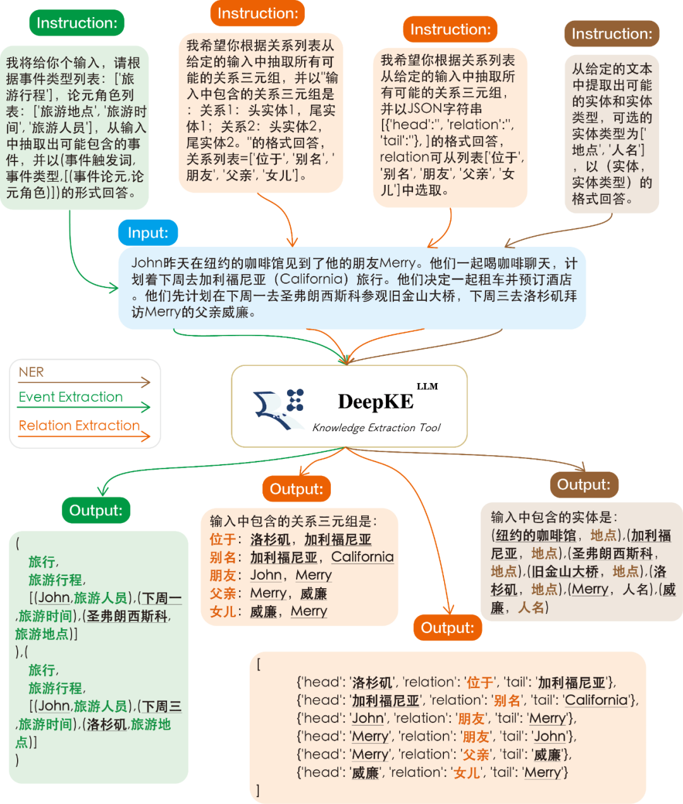
PLM-augmented KGs: 图谱构建
DeepKE-LLM: A Large Language Model Based Knowledge Extraction Toolkit

Slide 33
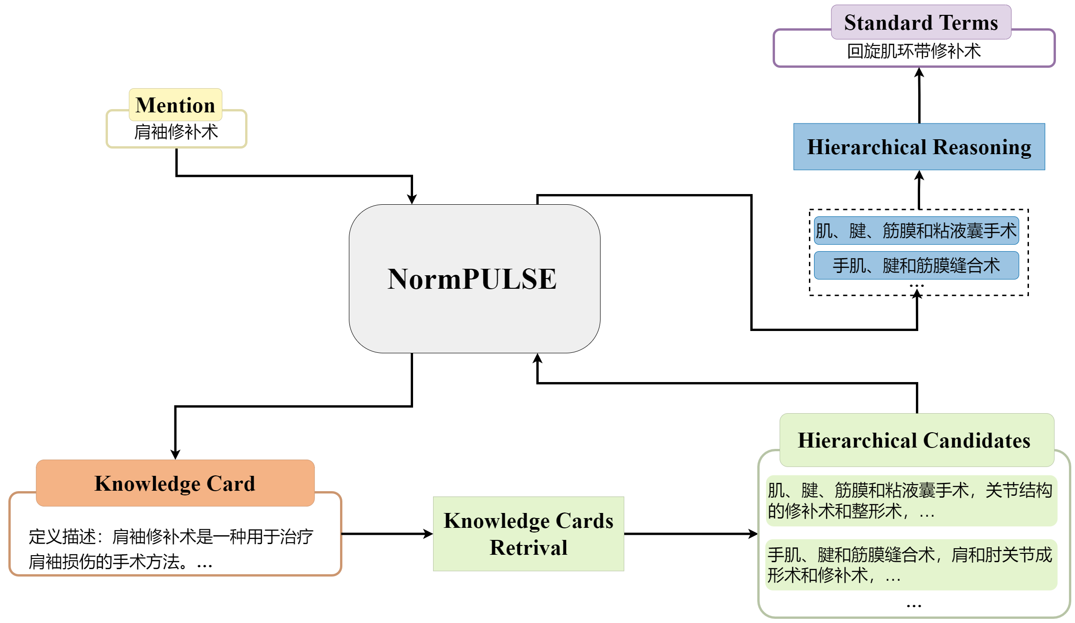
PLM-augmented KGs: 图谱构建
实体标准化
https://github.com/JOHNNY-fans/NormPULSE

Slide 34
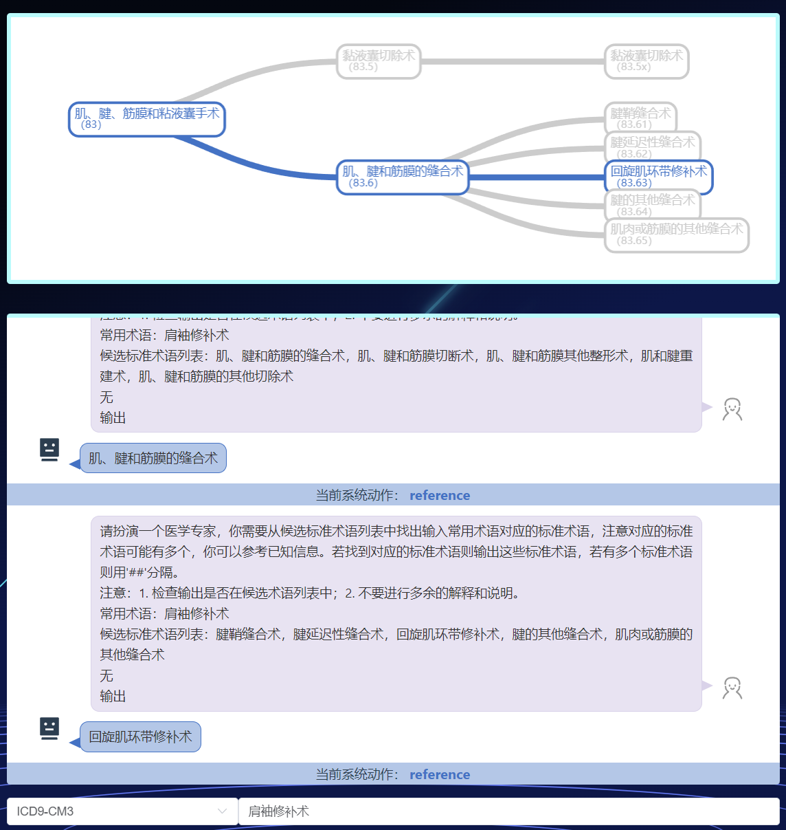
PLM-augmented KGs: 图谱构建
实体标准化
https://github.com/JOHNNY-fans/NormPULSE

Slide 35
PLM-augmented KGs: 图谱构建
实体发现
实体识别
实体分类 (Optional)
实体标准化
指代消解 (Optional)
关系分类
实体关系联合抽取
实体标准化

Slide 36
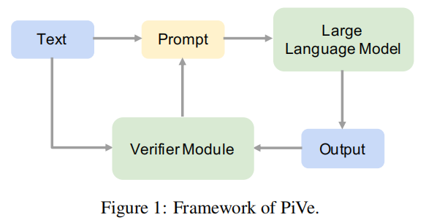
PLM-augmented KGs: 图谱构建
PiVe: Prompting with Iterative Verification Improving
Graph-based Generative Capability of LLMs

Slide 37
PLM-augmented KGs: 图谱构建
PLM
输入：
[初始Iteration的Prompt]
Transform the text into a semantic graph.
Example:
Text: Shotgate Thickets is a nature reserve in the UnitedKingdom operated by the Essex Wildlife Trust.
Semantic Graph: [["Shotgate Thickets", "instance of", "Nature reserve"], ["Shotgate Thickets", "country", "United Kingdom"], ["Shotgate Thickets", "operator", "Essex Wildlife Trust"]]
[INPUT TEXT]
[后续Iteration的Prompt]
Transform the text into a semantic graph and also add the given triples to the generated semantic graph.
Example:
Text: Shotgate Thickets is a nature reserve in the UnitedKingdom operated by the Essex Wildlife Trust.
Triples: ["Shotgate Thickets", "instance of", "Nature reserve"], ["Shotgate Thickets", "country", "United Kingdom"]
Semantic graph: [["Shotgate Thickets", "instance of", "Nature reserve"], ["Shotgate Thickets", "country", "United Kingdom"], ["Shotgate Thickets", "operator", "Essex Wildlife Trust"]]
[INPUT TEXT]
输出：[OUTPUT GRAPH]
PiVe: Prompting with Iterative Verification Improving
Graph-based Generative Capability of LLMs

Slide 38
PLM-augmented KGs: 图谱构建
Vertification Module
输入：文本与三元组列表拼接得到（用特殊Token <S>分隔）
输出：如果三元组列表是完整的，目标输出是“Correct”；
否则，目标输出是缺失的三元组。
PiVe: Prompting with Iterative Verification Improving
Graph-based Generative Capability of LLMs

Slide 39
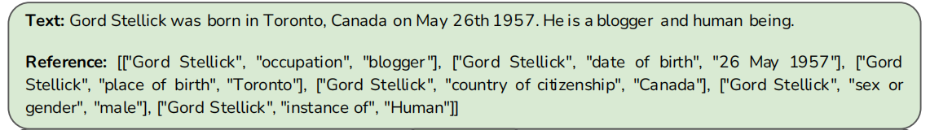
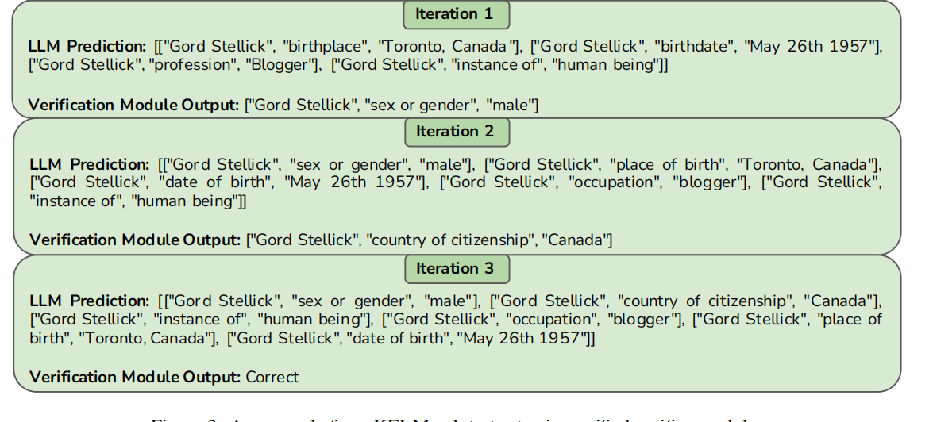
PLM-augmented KGs: 图谱构建
PiVe: Prompting with Iterative Verification Improving
Graph-based Generative Capability of LLMs

Slide 40
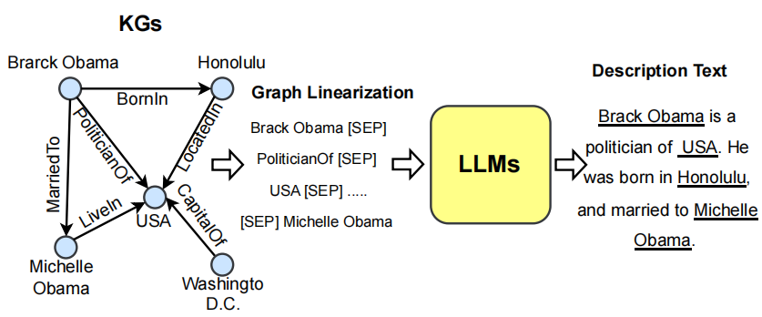
PLM-augmented KGs: Graph-to-Text

Slide 41
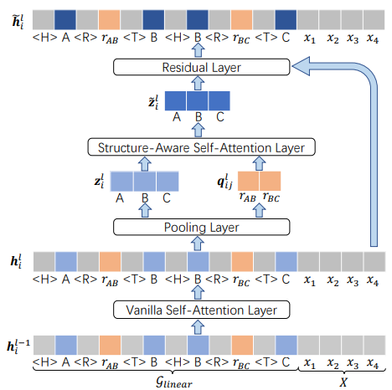
PLM-augmented KGs: Graph-to-Text
Decoder
Encoder
JointGT: Graph-Text Joint Representation Learning for
Text Generation from Knowledge Graphs

Slide 42
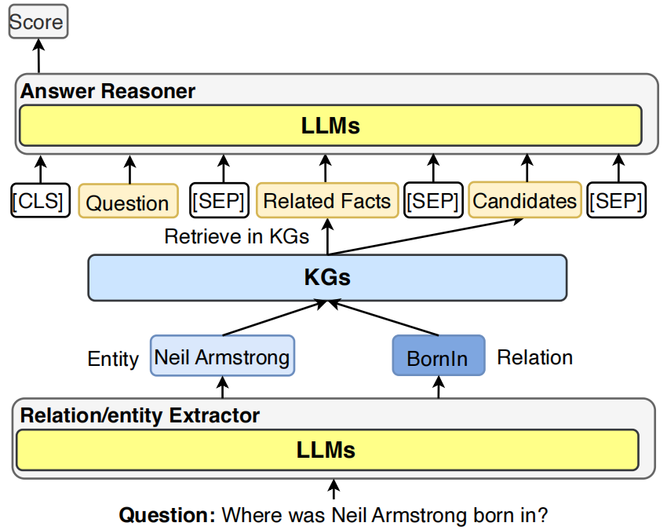
PLM-augmented KGs: 图谱问答

Slide 43
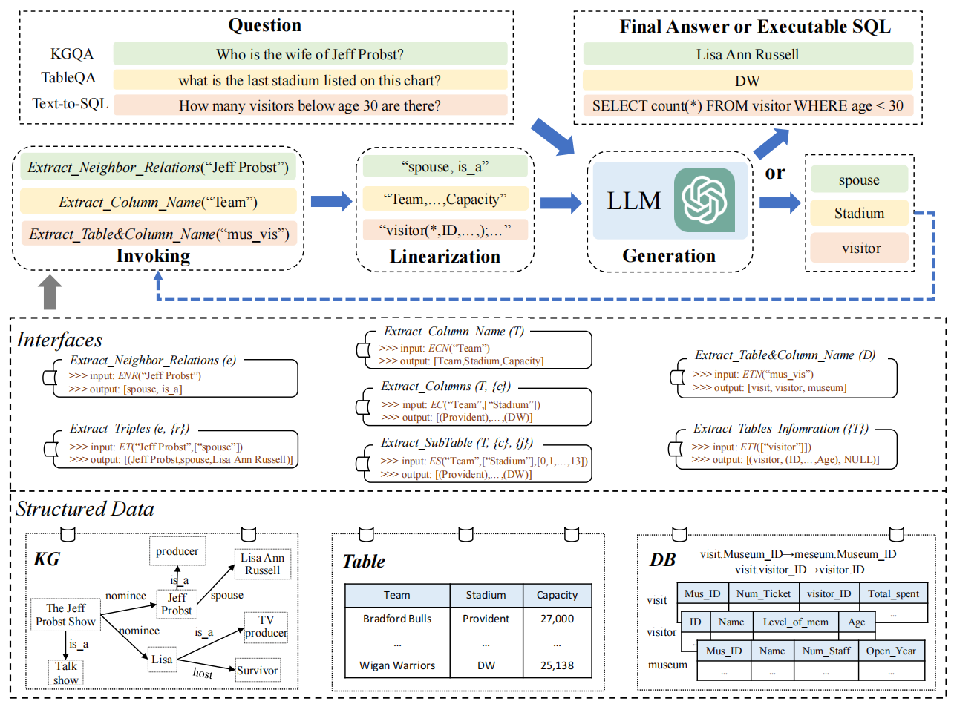
PLM-augmented KGs: 图谱问答
Based on [Y], please generate answer for the question [Q]
Here are [Y]. Which are most relevant to answer the question [Q]
Structgpt: A general framework for large language model to reason over structured data

Slide 44
主要内容
1.
KG-enhanced PLMs
2.
PLM-augmented KGs
3.
Future Directions

Slide 45
Future Directions
KGs for Hallucination Detection in PLMs
KGs for Editing Knowledge in PLMs
Multi-Modal PLMs for KGs
Synergized PLMs and KGs

Slide 46
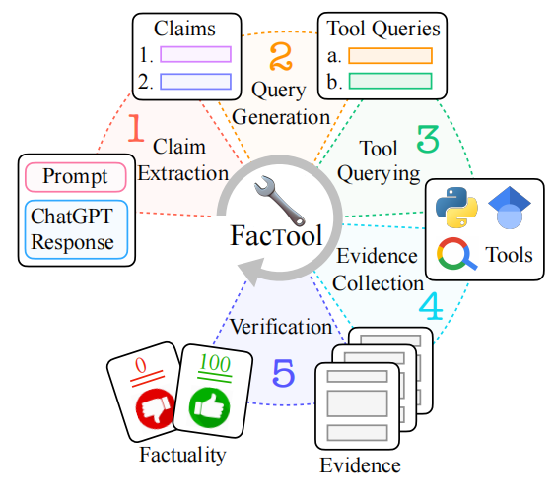
KGs for Hallucination Detection in PLMs
FACTOOL: Factuality Detection in Generative AI
A Tool Augmented Framework for Multi-Task and Multi-Domain Scenarios

Slide 47
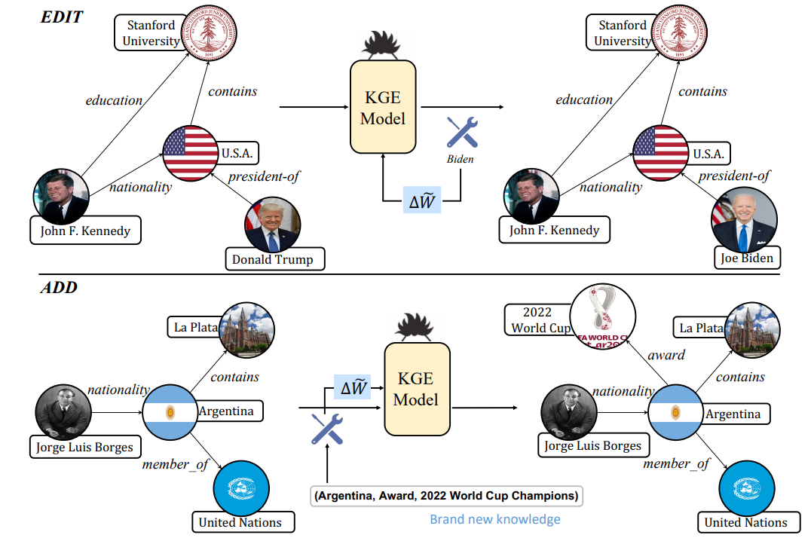
KGs for Editing Knowledge in PLMs
Editing language model-based knowledge graph embeddings
Related Paper: Locating and Editing Factual Associations in GPT

Slide 48
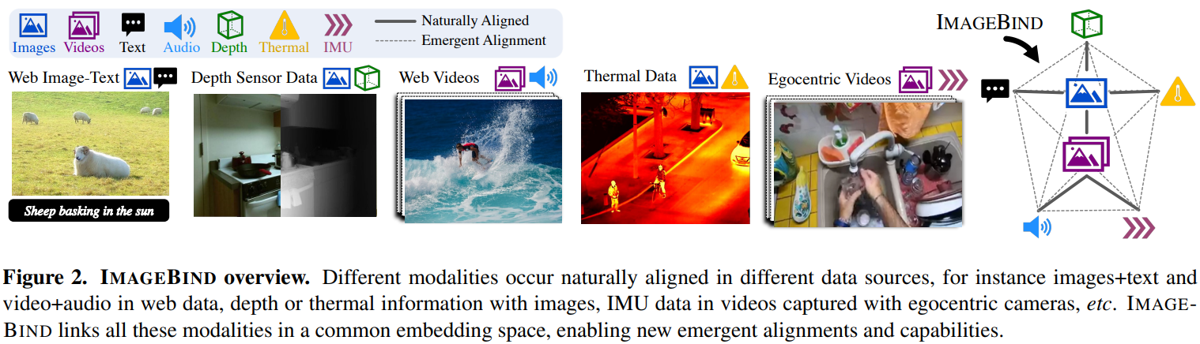
Multi-Modal PLMs for KGs
IMAGEBIND: One Embedding Space To Bind Them All

Slide 49
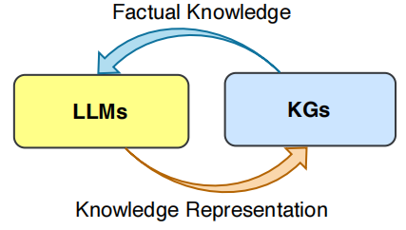
Synergized PLMs and KGs
KG Completion/Construction

Slide 50
Thanks!

